Slide 1


Fundamentals of Information System Security SEC285
Presented by Edward Alvarado
July 2022

Slide 2


Contents
Introduction
Week 2 through 6
Challenges
Career Skills Obtained
Conclusion

Slide 3
Introduction
The Internet of Things is growing exponentially. New technologies and applications are being developed on a regular basis. Throughout this course we reviewed the configuration and testing process on the Azure cloud platform includes encryption, stateful firewall, multiple factor authentication, and vulnerability assessment.
The following slides will review the primary topics covered in the course via step-by-step slides.

Slide 4
Module 2 Asymmetric Key Encryption
During this module we utilize azure virtual machines to connect to the Kali Server.
Once connected to the server we review the process of both Encryption and Decryption via the Terminal window.

Slide 5
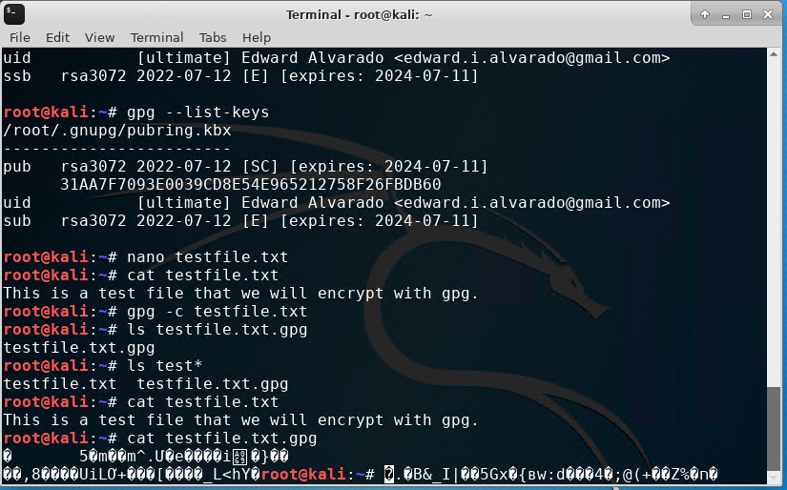
File Encryption
This screenshot should show the following.
Content of the plaintext file
Content of the encrypted file

Slide 6
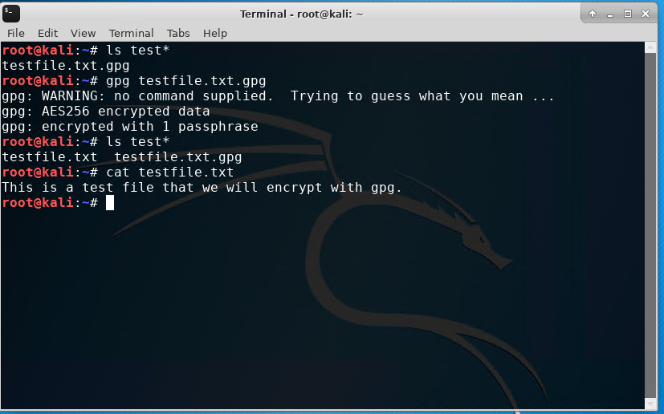
File Decryption
This screenshot should show the following.
The encrypted file being listed by itself
The decrypting process
Both the encrypted file and the original plaintext file being listed

Slide 7
Module 3 Stateful Firewall
During module 3 we continue to utilize the Kali virtual machine.
Utilizing the terminal, we establish IP Tables and perform an Nmap Scan of the Linux server.

Slide 8


Question
What effect does the sudo iptables --policy INPUT DROP command have on the access to computing resources?
Answer here:
The “sudo iptables –policy INPUT DROP” adds a rule in reference to incoming traffic, filtering the traffic in essence closing the previously open ports.

Slide 9
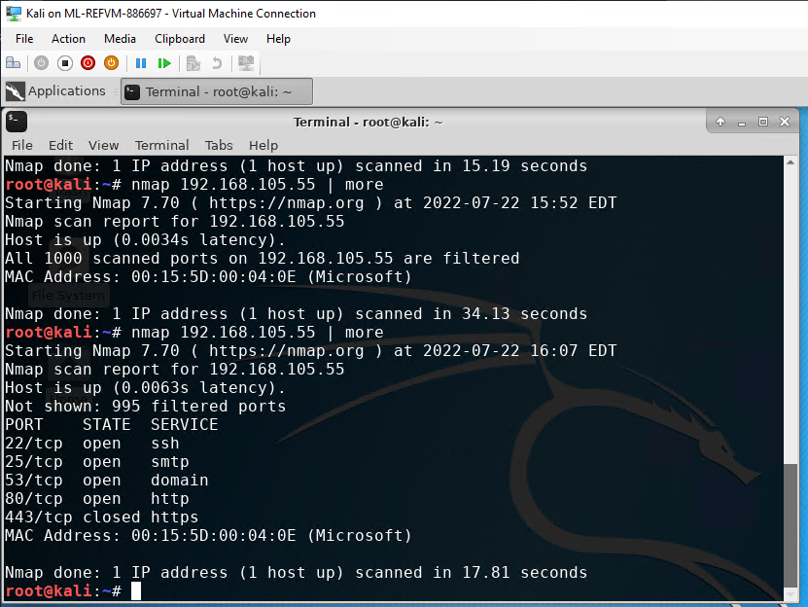
Nmap Scan
This screenshot should show the Nmap scan result of the Linux Server VM.

Slide 10
Module 4 Bring Your Own Device (BYOD) Security Policy
Module 4 broaches the topic of security policies and their importance within organizations.
The purpose of this security policy is to address the vulnerabilities that exists
within the organization. Americans were hit by an unprecedented rise in
cybercrime in 2021, with nearly 850,000 reports to the FBI and losses surpassing
$6.9 billion. It is estimated that, worldwide, cybercrimes will cost $10.5
trillion annually by 2025. Getting ahead of the curve to close off vulnerabilities
will help curb losses and maintain company resources.

Slide 11
BYOD Security Policy
This slide should have the complete security policy template inserted as an object.

Slide 12
Module 5 Multifactor Authentication (MFA)
In module 5 we review multifactor authentication.
We setup multifactor authentication utilizing the Ubuntu VM terminal and Google Authenticator.

Slide 13
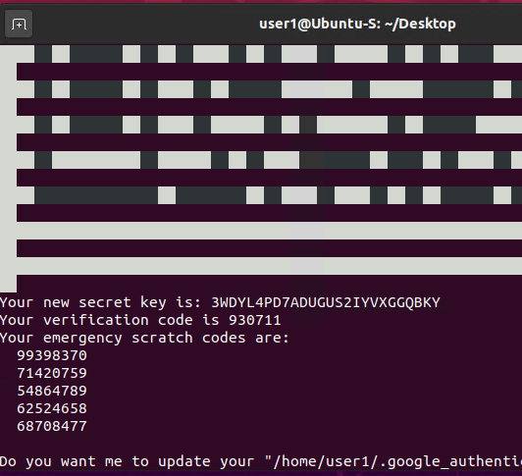
Common-auth Configuration File
This screenshot should show the entry that indicates the use of the Google Authenticator module.

Slide 14
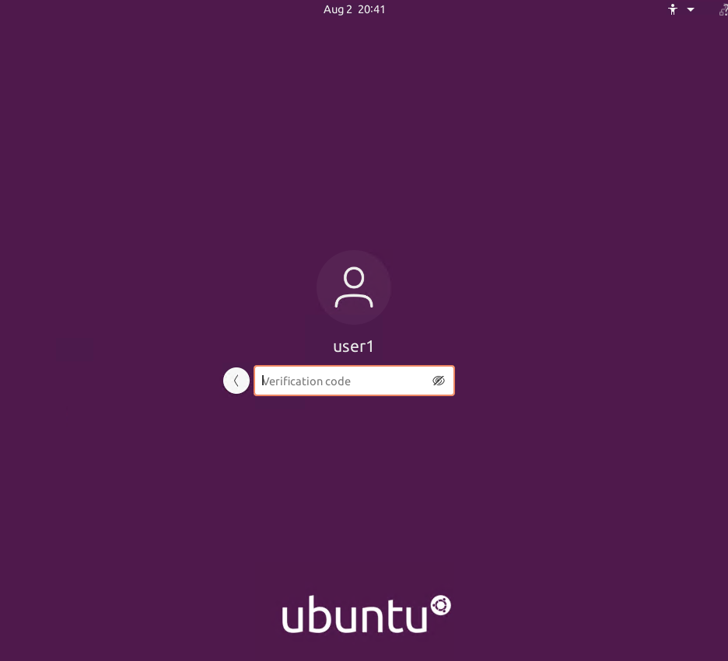
MFA Logon Screen
This screenshot should show the logon screen where a verification code is required.

Slide 15
Module 6 Vulnerability Assessment
During module 6 we review multiple activities utilizing Linux and Kali virtual machines.
Nmap, NetCat and Wireshark are used to review and measure network activity
Nessus is used to review overall network vulnerabilities on the Linux server

Slide 16
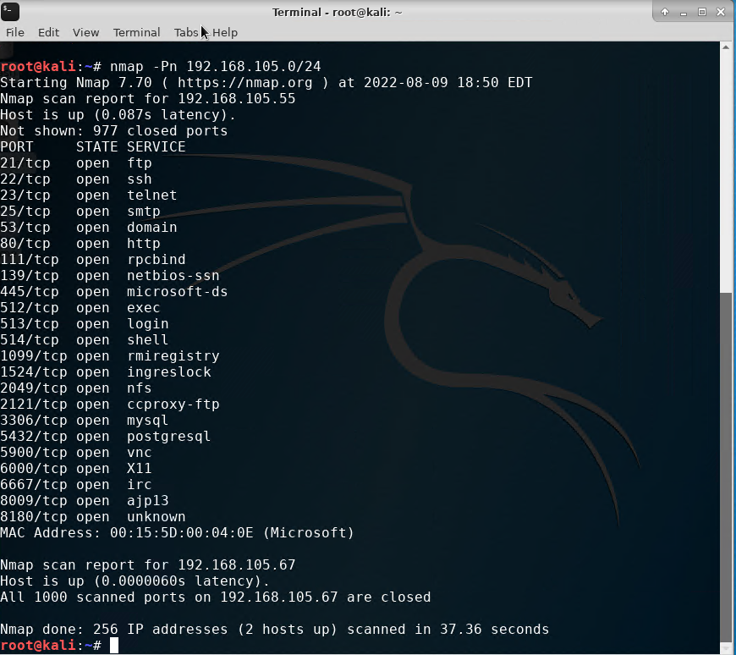
Nmap
This screenshot should include the scan result showing both the Kali and Linux Server VMs.

Slide 17

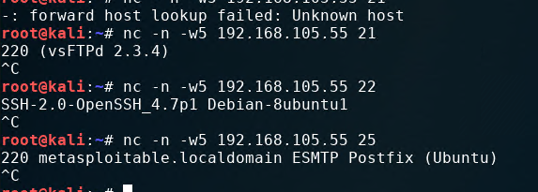
NetCat
This screenshot should include the scan result showing both the Kali and Linux Server VMs.

Slide 18
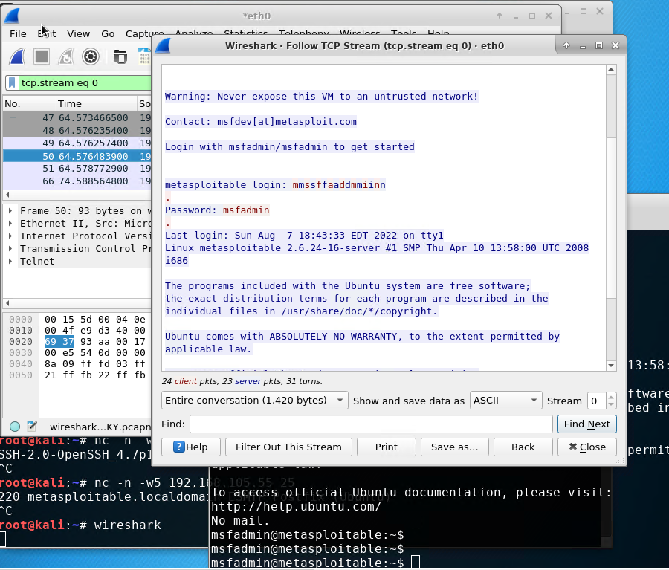
Wireshark
This screenshot should include the Wireshark—Follow TCP Steam window showing the Telnet username and password.

Slide 19
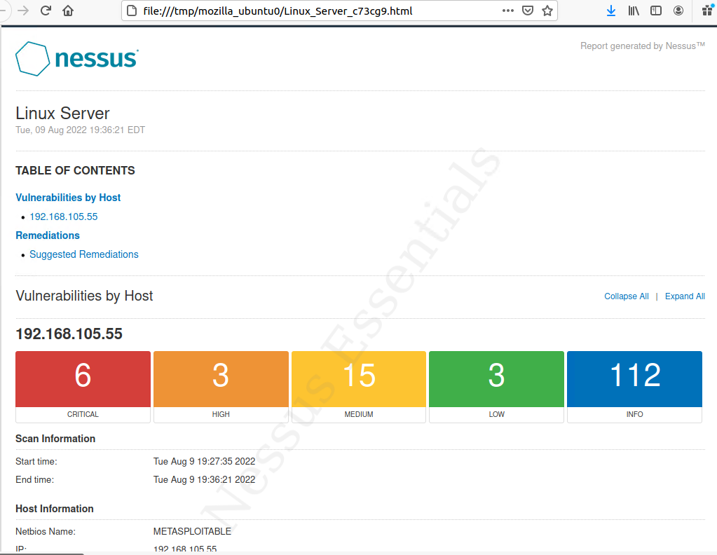
Nessus
This screenshot should include the high-level view of the Nessus vulnerability scan report (showing categories of vulnerability in different colors).

Slide 20
Challenges
The initial challenge of this course was establishing each virtual machine correctly and making sure the terminals of each weren’t mistaken for each other.
Another challenge was Nessus tool, initially the tool didn’t work, and I had to clear the cache on the virtual machines browser to get things working again.

Slide 21
Career Skills Obtained
By the end of this course, I have grown more familiar with Linux, Kali and Ubuntu Servers.
I have a better understanding of network security and the vulnerabilities that exist by default with most system.
I now have a familiarity with tools like Nessus that will allow me to diagnose network vulnerabilities and fix them in the future.

Slide 22

Conclusion
This course has taught me the fundamentals of information security. How to configure and test processes on the Azure cloud platform includes encryption, stateful firewall, multiple factor authentication, and vulnerability assessment.
I will take the information learned in this course and apply it to my career in the future.

